Slide 1

Java Keywords

Slide 2
Java Keywords
Static
Final
Abstract
Synchronized
Transient
Volatile
native

Slide 3
static keyword
Used for memory management
to share the same variable or method of a given class.
The users can apply static keywords with variables, methods, blocks, and nested classes.
used for a constant variable or a method that is the same for every instance of a class.

Slide 4
Static keyword
Static keyword can be applied to:
Blocks
Variables
Methods
Classes

Slide 5
Static keyword
Shared memory allocation: Static variables and methods are allocated memory space only once during the execution of the program. This memory space is shared among all instances of the class, which makes static members useful for maintaining global state or shared functionality.
Accessible without object instantiation: Static members can be accessed without the need to create an instance of the class. This makes them useful for providing utility functions and constants that can be used across the entire program.

Slide 6
Static keyword
Associated with class, not objects: Static members are associated with the class, not with individual objects. This means that changes to a static member are reflected in all instances of the class, and that you can access static members using the class name rather than an object reference.
Cannot access non-static members: Static methods and variables cannot access non-static members of a class, as they are not associated with any particular instance of the class.

Slide 7
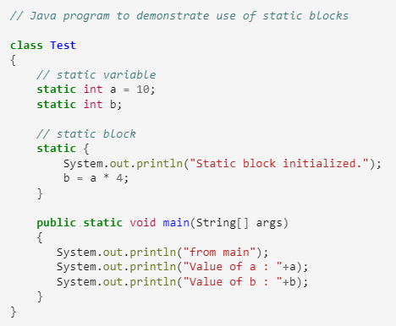

Slide 8
Static variables and Members
When a variable is declared as static, then a single copy of the variable is created and shared among all objects at the class level. Static variables are, essentially, global variables. All instances of the class share the same static variable.
When a method is declared with the static keyword, it is known as the static method. The most common example of a static method is the main( ) method. Any static member can be accessed before any objects of its class are created, and without reference to any object. Methods declared as static have several restrictions:

Slide 9
Static methods restrictions
They can only directly call other static methods.
They can only directly access static data.
They cannot refer to this or super in any way.

Slide 10
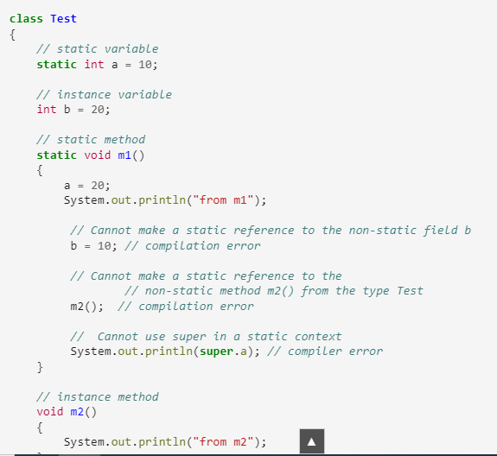

Slide 11
The final keyword
The final method in Java is used as a non-access modifier applicable only to a variable, a method, or a class. It is used to restrict a user in Java.
The following are different contexts where the final is used:
Variable
Method
Class

Slide 12
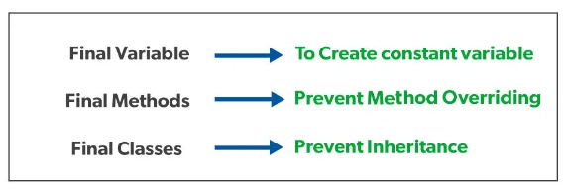
Final keyword

Slide 13
Characteristics of final keyword
the final keyword in java is used to indicate that a variable, method, or class cannot be modified or extended. Here are some of its characteristics:
Final variables: When a variable is declared as final, its value cannot be changed once it has been initialized. This is useful for declaring constants or other values that should not be modified.
Final methods: When a method is declared as final, it cannot be overridden by a subclass. This is useful for methods that are part of a class’s public API and should not be modified by subclasses.

Slide 14
Final keyword
Final classes: When a class is declared as final, it cannot be extended by a subclass. This is useful for classes that are intended to be used as is and should not be modified or extended.
Initialization: Final variables must be initialized either at the time of declaration or in the constructor of the class. This ensures that the value of the variable is set and cannot be changed.

Slide 15
Final keyword
Performance: The use of a final can sometimes improve performance, as the compiler can optimize the code more effectively when it knows that a variable or method cannot be changed.
Security: The final can help improve security by preventing malicious code from modifying sensitive data or behavior.

Slide 16
final
public class ConstantExample {
public static void main(String[] args) {
// Define a constant variable PI
final double PI = 3.14159;
// Print the value of PI
System.out.println("Value of PI: " + PI);
}
}

Slide 17
Serialization and Deserialization in Java
Serialization is a mechanism of converting the state of an object into a byte stream.
Deserialization is the reverse process where the byte stream is used to recreate the actual Java object in memory. This mechanism is used to persist the object.

Slide 18
Synchronization in Java
Java Synchronization is used to make sure by some synchronization method that only one thread can access the resource at a given point in time.
Multi-threaded programs may often come to a situation where multiple threads try to access the same resources and finally produce erroneous

Slide 19
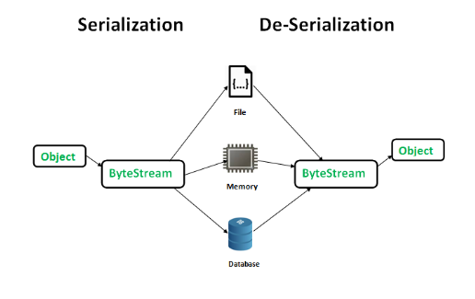
Serialization/Deserialization

Slide 20
The byte stream created is platform independent. So, the object serialized on one platform can be deserialized on a different platform. To make a Java object serializable we implement the java.io.Serializable interface. The ObjectOutputStream class contains writeObject() method for serializing an Object.

Slide 21
Transient in Java
transient is a variables modifier used in serialization.
At the time of serialization, if we don’t want to save value of a particular variable in a file, then we use transient keyword.
When JVM comes across transient keyword, it ignores original value of the variable and save default value of that variable data type.

Slide 22
transient
transient keyword plays an important role to meet security constraints.
There are various real-life examples where we don’t want to save private data in file.
Another use of transient keyword is not to serialize the variable whose value can be calculated/derived using other serialized objects or system such as age of a person, current date, etc.
serialization is all about to save state of an object to a file.

